Slide 1
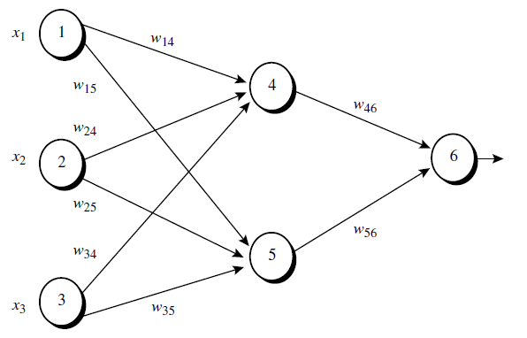

Example
Sample calculations for learning by the backpropagation algorithm. Figure shows a multilayer feed-forward neural network. Let the learning rate be 0.9. The initial weight and bias values of the network are given in Table , along with the first training tuple, X = (1, 0, 1), whose class label is 1.

Slide 2
Example
Sample calculations for learning by the backpropagation algorithm. Figure shows a multilayer feed-forward neural network. Let the learning rate be 0.9. The initial weight and bias values of the network are given in Table , along with the first training tuple, X = (1, 0, 1), whose class label is 1.

Slide 3
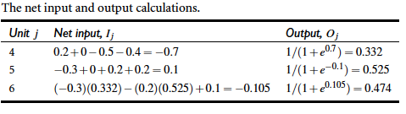


Net Input and Output Calculation
Net Input
Net Output

Slide 4
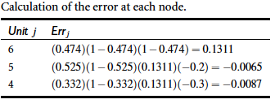


Calculation of error at each node
Output Node
Hidden Node

Slide 5
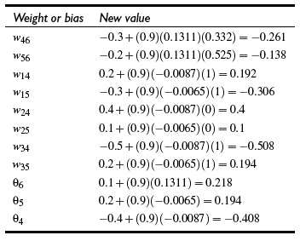


Calculation of Weights and Biases Updating
Weight Update
Bias Update

Slide 6
Neural Network as a Classifier
Weakness
Long training time
Require a number of parameters typically best determined empirically, e.g., the network topology or “structure.”
Poor interpretability: Difficult to interpret the symbolic meaning behind the learned weights and of “hidden units” in the network
Strength
High tolerance to noisy data
Ability to classify untrained patterns
Successful on an array of real-world data, e.g., hand-written letters
Techniques have recently been developed for the extraction of rules from trained neural networks

